Slide 1

Clustering
Note to other teachers and users of these slides: We would be delighted if you found our
material useful for giving your own lectures. Feel free to use these slides verbatim, or to
modify them to fit your own needs. If you make use of a significant portion of these slides
in your own lecture, please include this message, or a link to our web site: http://www.mmds.org
CS246: Mining Massive Datasets
Jure Leskovec, Stanford University
Mina Ghashami, Stanford University
http://cs246.stanford.edu

Slide 2
The Problem of Clustering
Given a set of points, with a notion of distance between points, group the points into some number of clusters, so that
Members of the same cluster are close/similar to each other
Members of different clusters are dissimilar
Usually:
Points are in a high-dimensional space
Similarity is defined using a distance measure
Euclidean, Cosine, Jaccard, edit distance, …

Slide 3
Example: Clusters & Outliers
x
xx x
x x
x x x
x
x x x
x
x
xx x
x x
x x x
x
x x x
x
x
x x
x x x x
x x x x
x x x
x x
x x
x x x x
x x x x
x x x
x x
x x
x x x x
x x x
x
x x
x x x x
x x x
x
x
Outlier
Cluster

Slide 4
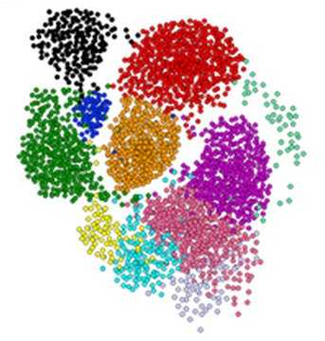
Clustering is a hard problem!

Slide 5
Why is it hard?
Clustering in two dimensions looks easy
Clustering small amounts of data looks easy
Many applications involve not 2, but 10 or 10,000 dimensions
High-dimensional spaces look different: Almost all pairs of points are very far from each other --> The Curse of Dimensionality!

Slide 6
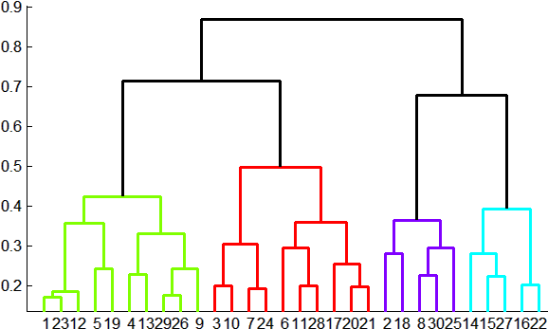
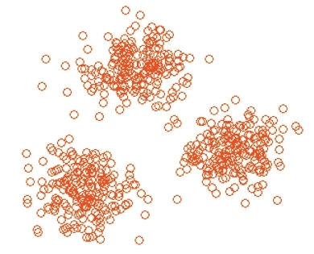
Overview: Clustering Strategies (1)
Two group of methods:
Hierarchical:
Agglomerative (bottom up):
Initially, each point is a cluster
Repeatedly combine the two “nearest” clusters into one
Divisive (top down):
Start with one cluster and recursively split it
Point assignment:
Maintain a set of clusters
Points belong to the “nearest” cluster

Slide 7
Overview: Clustering Strategies (2)
In Euclidean:
Points are vectors of real numbers, i.e. coordinates
It is possible to summarize a collection of points as their average. We call it centroid.
Distance measure: L2 norm, L1 norm
In non-Euclidean:
There is no notion of location, and centroid
We summarize a collection of points differently
Distance measures: Jaccard, Hamming, cosine

Slide 8
Overview: Clustering Strategies (3)
Does the data fit in memory or does it reside on disk?
In-memory clustering is more straightforward
Example: K-means
Large-data clustering requires loading one batch of data at a time, cluster them in memory and keep summaries of clusters
Example: BFR, CURE

Slide 9
Hierarchical vs point-assignment
Point assignment good when clusters are nice, convex shapes:
Hierarchical can win when shapes are weird:
Note both clusters have essentially the same centroid.

Slide 10
Hierarchical Clustering

Slide 11
Hierarchical Clustering
Key operation: Repeatedly merge two
“nearest” clusters
Three important questions:
1) How to represent a cluster?
2) How to determine the nearness of clusters?
3) When to stop merging clusters?

Slide 12
Hierarchical Clustering: Euclidean
In Euclidean case:
(1) How to represent a cluster of many points?
As we merge clusters, we represent the “location” of each cluster by its
centroid = average of its (data)points
(2) How to determine the nearness of clusters?
Measure cluster distances by distances of centroids
Merge two clusters with the shortest distance

Slide 13
Example: Hierarchical clustering
(5,3)
o
(1,2)
o
o (2,1) o (4,1)
o (0,0) o (5,0)
x (1.5,1.5)
x (4.7,1.3)
x (1,1)
x (4.5,0.5)
Data:
o … data point
x … centroid
Dendrogram

Slide 14
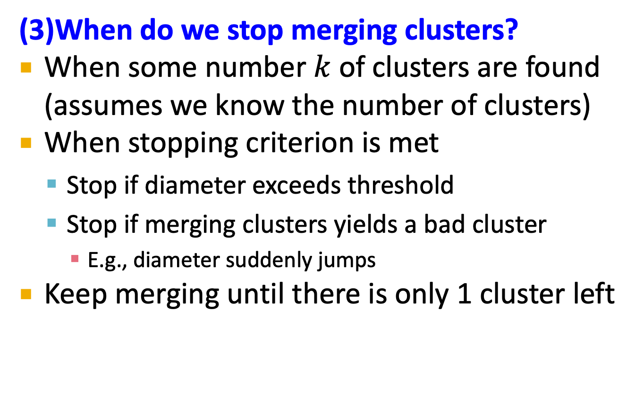
When to Stop?
(3)When do we stop merging clusters?
When some number $k$ of clusters are found (assumes we know the number of clusters)
When stopping criterion is met
Stop if diameter exceeds threshold
Stop if merging clusters yields a bad cluster
E.g., diameter suddenly jumps
Keep merging until there is only 1 cluster left

Slide 15
k-means Clustering

Slide 16
k–means Algorithm(s)
It is a problem formulation, not an algorithm.
Problem: Given Euclidean space/distance and k = number of clusters, find cluster centers that minimizes sum of squared distances from each point to its cluster center
Finding an exact solution is NP-hard.
The approximate solution is LIoyd’s algorithm or the k-means algorithm.

Slide 17
k–means Algorithm(s)
Initialize clusters by picking k centers
Until convergence:
1) For each point, assign it to the cluster whose current centroid is the closest
2) After all points are assigned, update the centroids of the k clusters as average of datapoints within each cluster
Convergence means Points don’t move between clusters and centroids stabilize

Slide 18
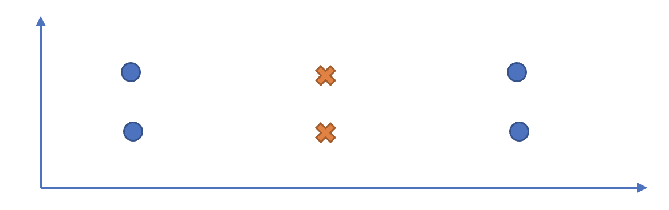
Shortcoming of k-means
Convergence of k-means heavily depends on the initial pick of centroids. It can perform arbitrarily bad.
Different strategies for picking k centers:
Pick k datapoints at random
K-means ++

Slide 19
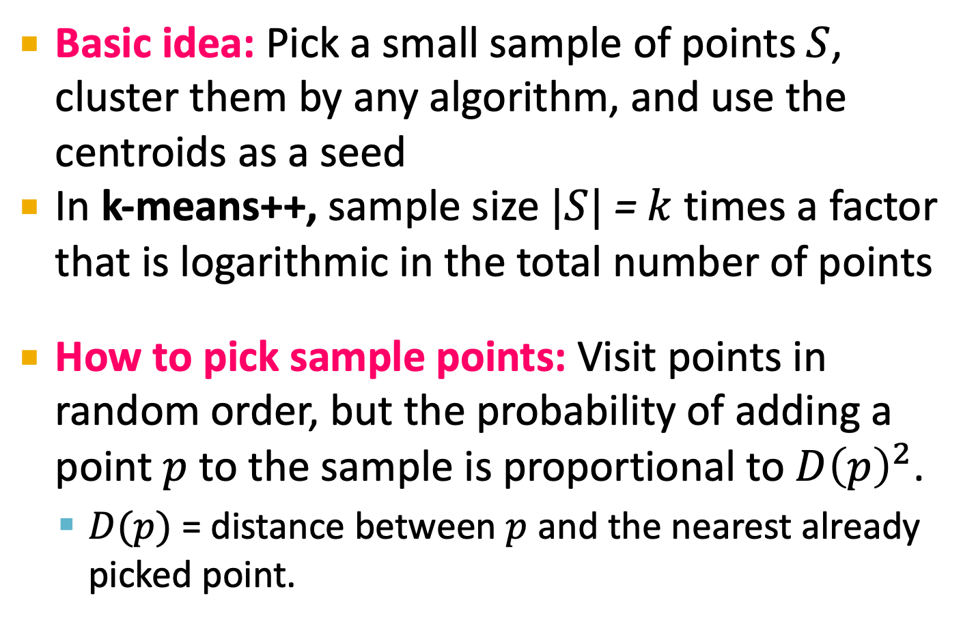
k-Means++
Basic idea: Pick a small sample of points$S$, cluster them by any algorithm, and use the centroids as a seed
In k-means++, sample size $|S|$ = $k$ times a factor that is logarithmic in the total number of points
How to pick sample points: Visit points in random order, but the probability of adding a point $p$ to the sample is proportional to $D{\left(p\right)}^{2}$.
$D(p)$ = distance between $p$ and the nearest already picked point.

Slide 20
Example: Assigning Clusters
x
x
x
x
x
x
x
x
x
x
x
x … data point
… centroid
Clusters after round 1

Slide 21
Example: Assigning Clusters
x
x
x
x
x
x
x
x
x
x
x
x … data point
… centroid
Clusters after round 2

Slide 22
Example: Assigning Clusters
x
x
x
x
x
x
x
x
x
x
x
x … data point
… centroid
Clusters at the end

Slide 23
Getting the k right
How to select k?
Try different k, looking at the change in the average distance to centroid as k increases
Average falls rapidly until right k, then changes little
Best value
of k
Average
distance to
centroid
k

Slide 24
Example: Picking k
x
xx x
x x
x x x
x
x x x
x
Too few;
many long
distances
to centroid
x
x x
x x x x
x x x x
x x x
x x
x x
x x x x
x x x
x
x

Slide 25
Example: Picking k
x
xx x
x x
x x x
x
x x x
x
x
Just right;
distances
rather short
x x
x x x x
x x x x
x x x
x x
x x
x x x x
x x x
x
x

Slide 26
Example: Picking k
Too many;
little improvement
in average
distance
x
xx x
x x
x x x
x
x x x
x
x
x x
x x x x
x x x x
x x x
x x
x x
x x x x
x x x
x
x

Slide 27
Summary
Clustering: Given a set of points, with a notion of distance between points, group the points into some number of clusters
Algorithms:
Agglomerative hierarchical clustering:
Centroid and clustroid
k-means:
Initialization, picking k

